Slide 1

Test Driven Development
Test Driven Development

Slide 2

What is Test Driven Development

Slide 3
Red
Green
Refactor

Slide 4
Write Test
Write Code
Refactor

Slide 5
Uncle Bob’s Three Rules Of TDD: Rule #1
You are not allowed to write any production code unless it is to make a failing unit test pass.

Slide 6
Uncle Bob’s Three Rules Of TDD: Rule #2
You are not allowed to write any more of a unit test than is sufficient to fail; and compilation failures are failures.

Slide 7
Uncle Bob’s Three Rules Of TDD: Rule #3
You are not allowed to write any more production code than is sufficient to pass the one failing unit test.

Slide 8
What’s In It For Me?!

Slide 9
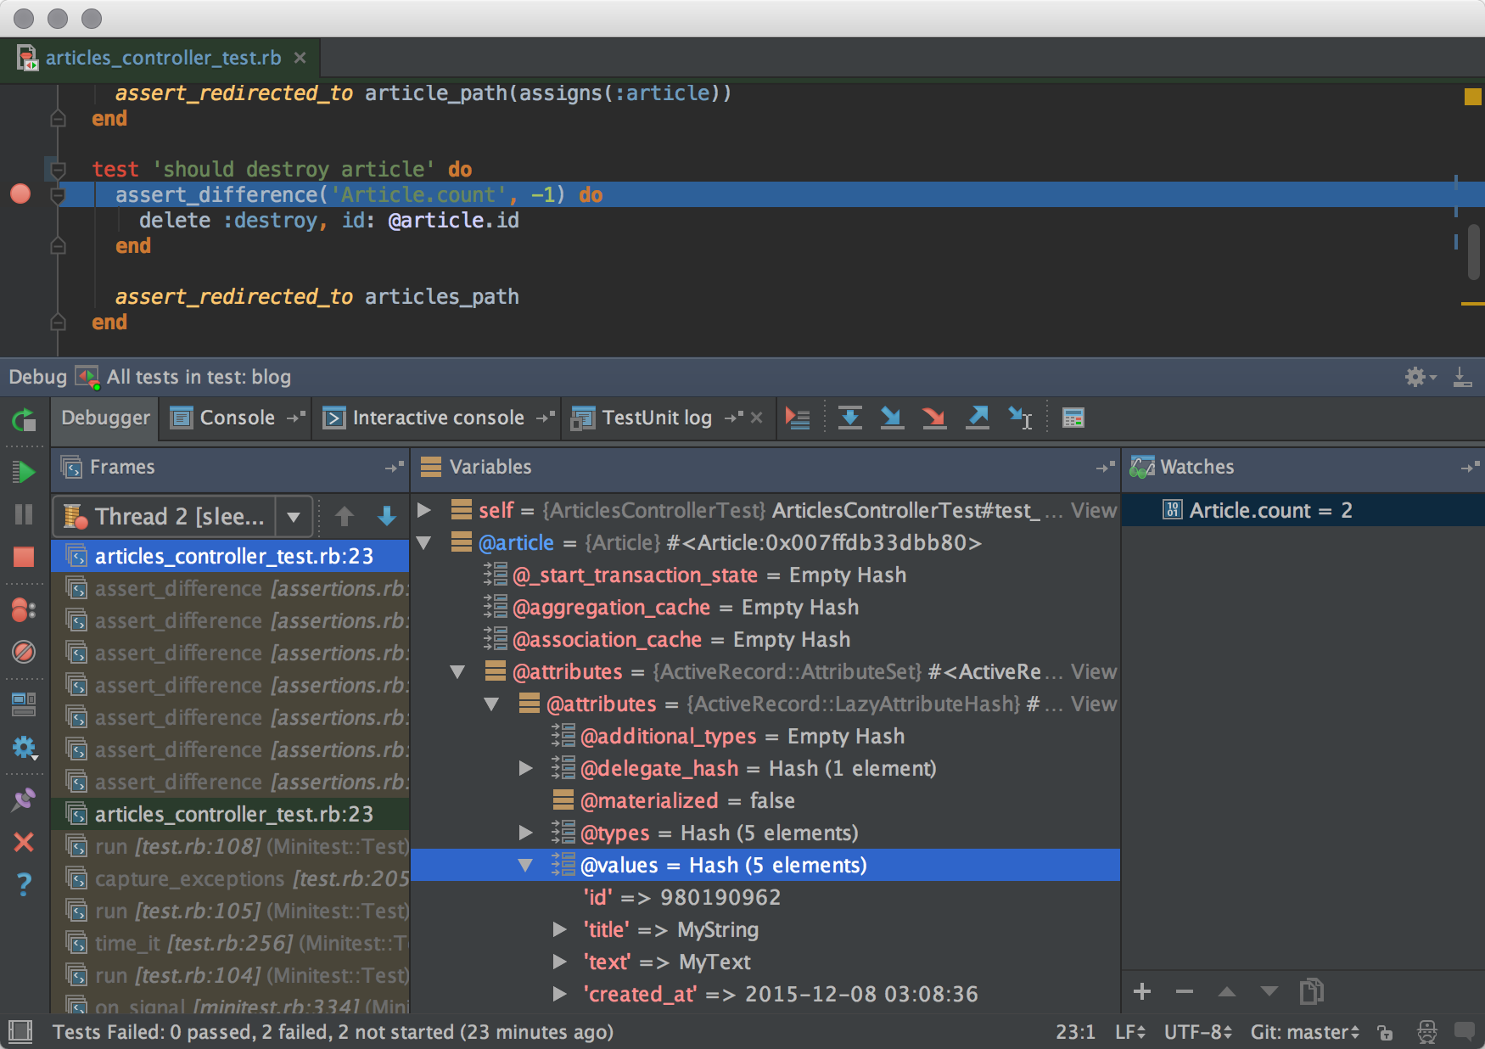
Notes:
Less Time At The Debugger

Slide 10
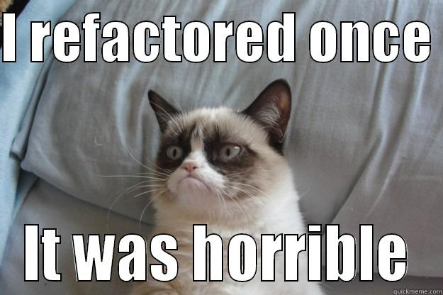
Notes:
Increased confidence in ability to refactor without breaking existing functionality

Slide 11
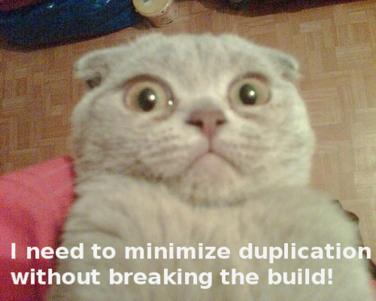
Notes:
Ease code maintenance

Slide 12
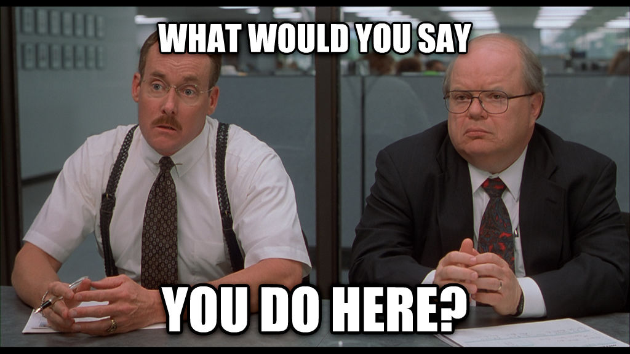
Notes:
Cleaner interfaces

Slide 13
Could ZOMBIES Help You With Test Driven Development?

Slide 14
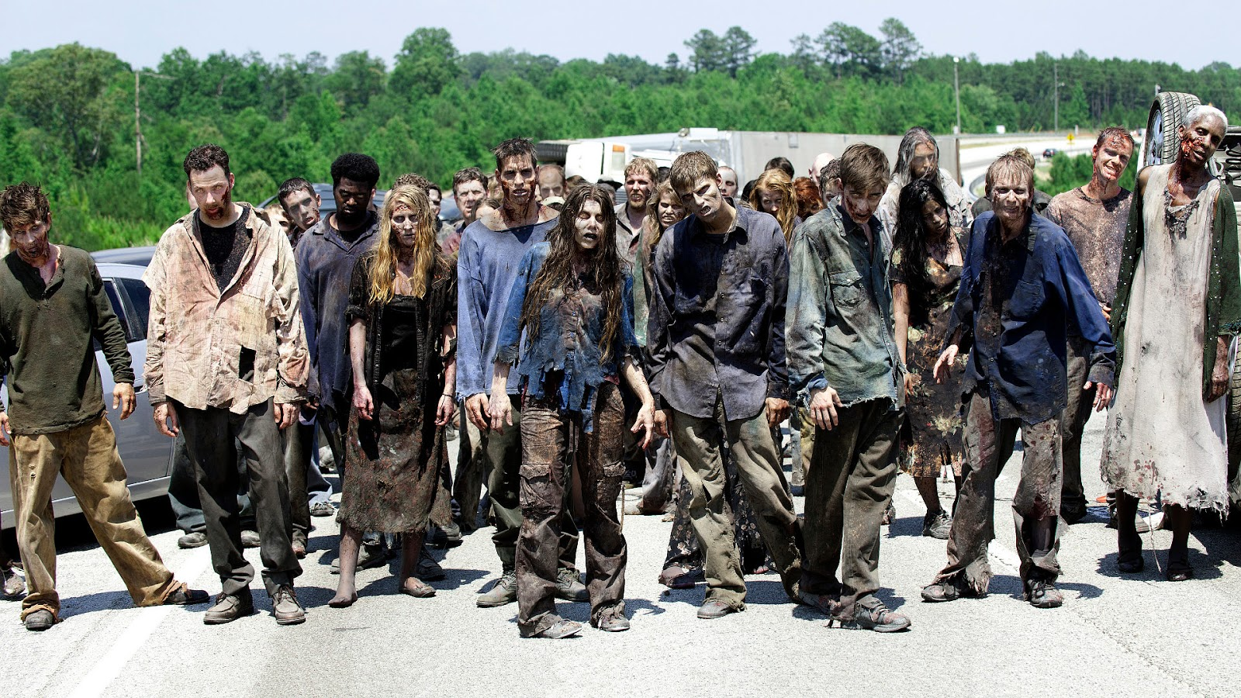

Slide 15
No, Not Those ZOMBIES…
Notes:
ZOMBIES is an acronym

Slide 16
Why Is TDD Initially Difficult?
Notes:
Which test do I write?
It’s hard to know where to start.
When do I know when I’m done?
What if I leave something incomplete?
How can ZOMBIES help me with these scary problems?

Slide 17
Z - Zero
O - One
M – Many (or More complex)
B – Boundary Behaviors
I – Interface Definition
E – Exercise Exceptional Behavior
S – Simple Scenarios, Simple Solutions

Slide 18
ZOM
Zero Test – Initial Tests
One Test – Test for basic behaviors
Many Tests – Test for complex behaviors

Slide 19
BIE
Behavioral Tests
Interface Tests
Exception Tests

Slide 20
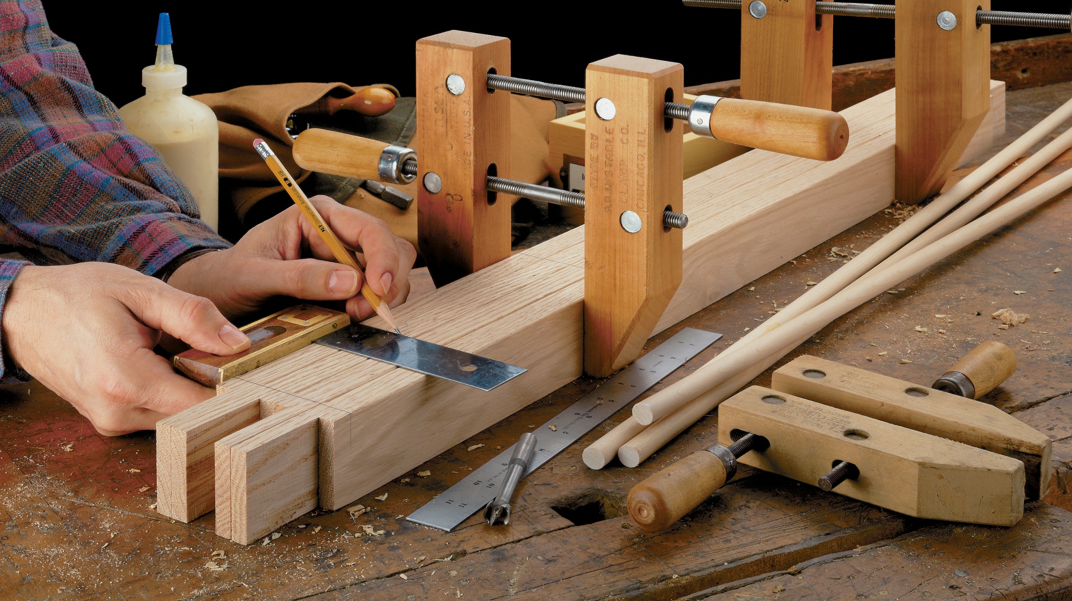
Lets Build Something

Slide 21
Who knows what a stack is?

Slide 22


Slide 24
Push
1

Slide 25
Push
1

Slide 26
Push
2
1

Slide 27
Push
2
1

Slide 28
Push
3
2
1

Slide 29
Size?
3
2
1

Slide 30
Peek
3
2
1

Slide 31
Pop
3
2
1

Slide 32
Pop
2
1
3

Slide 33
Pop
1
2
3

Slide 34
Pop
1
2
3

Slide 35
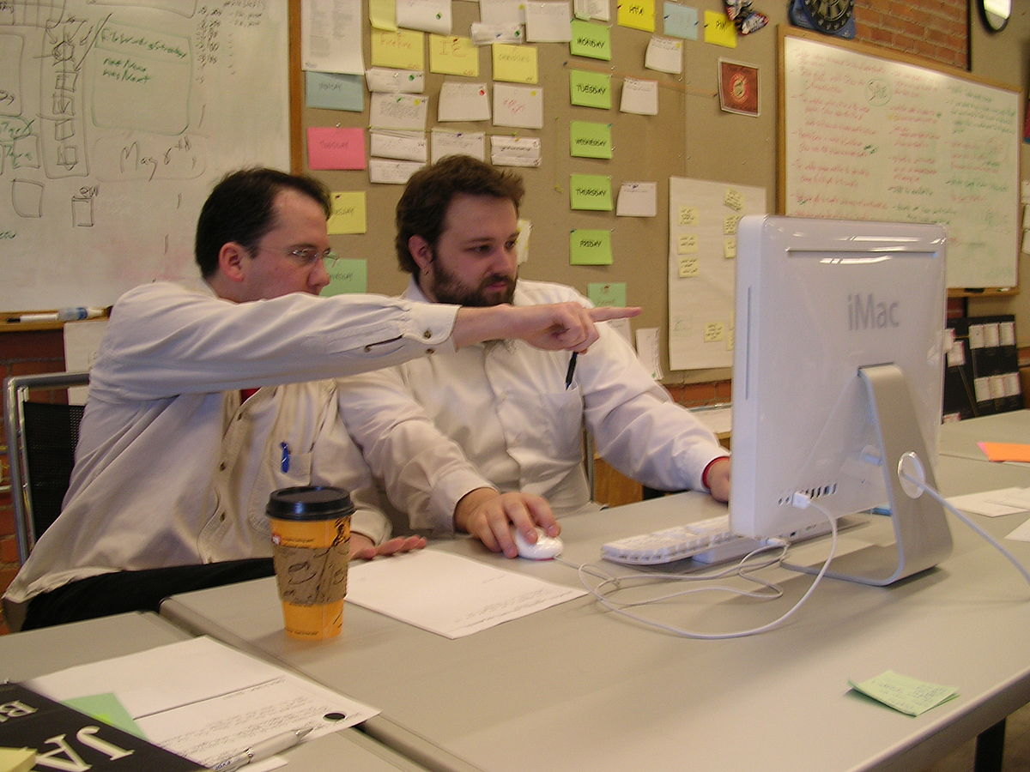
Time To Pair Up

Slide 36
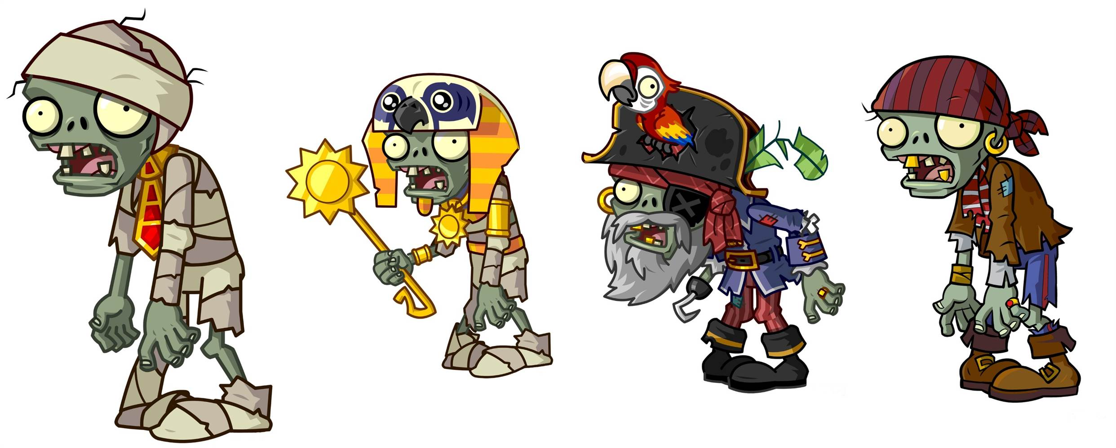

Slide 37
Quick Start for Java Folks
git clone --branch v1.0 https://github.com/skatra/tdd-stack.git

Slide 38
Your Mission, Should You Choose to Accept It
Complete the steps below to out run the ZOMBIES and get to safety!
Project Setup
Should be able to determine the size of the stack
Should be able to set the capacity of the stack
Should be able to push integers onto the stack
Should be able to pop integers off of the stack
Should be able to peek at the integer on the stack without removing it

Slide 39


Slide 40

Should be able to determine the size of the stack
Should be able to set the capacity of the stack

Slide 41
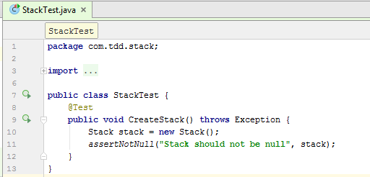

Slide 42
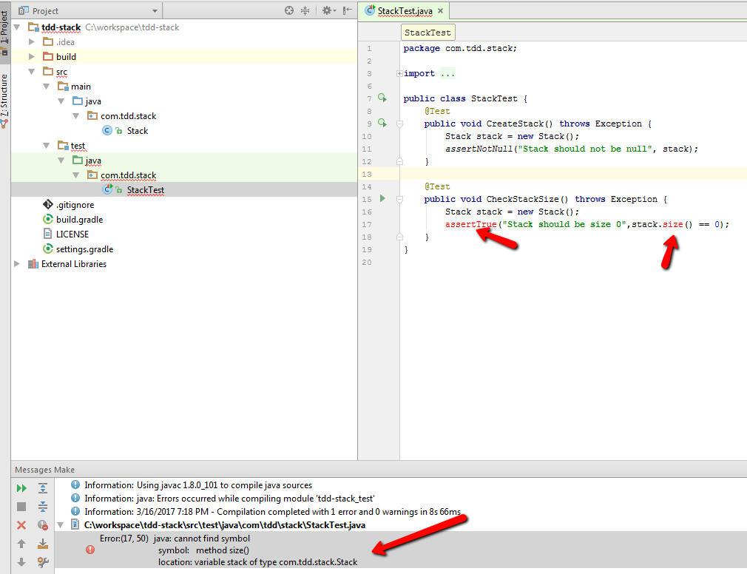

Slide 43
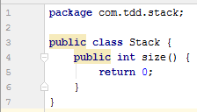

Slide 44
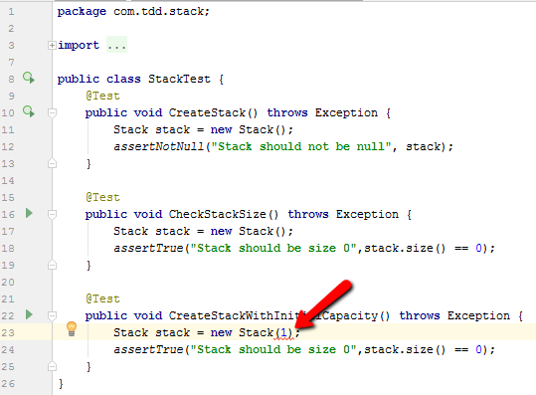

Slide 45
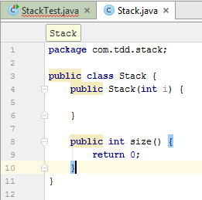

Slide 46
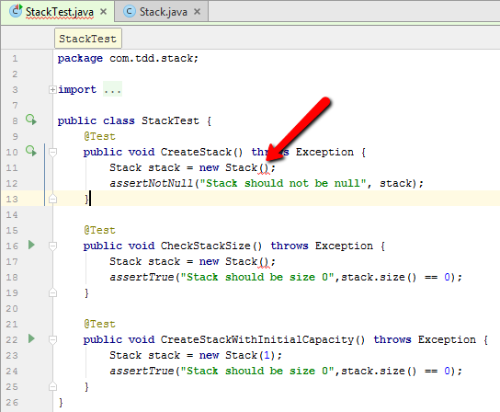

Slide 47
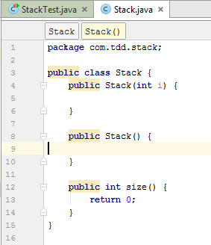
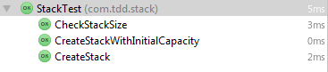

Slide 48
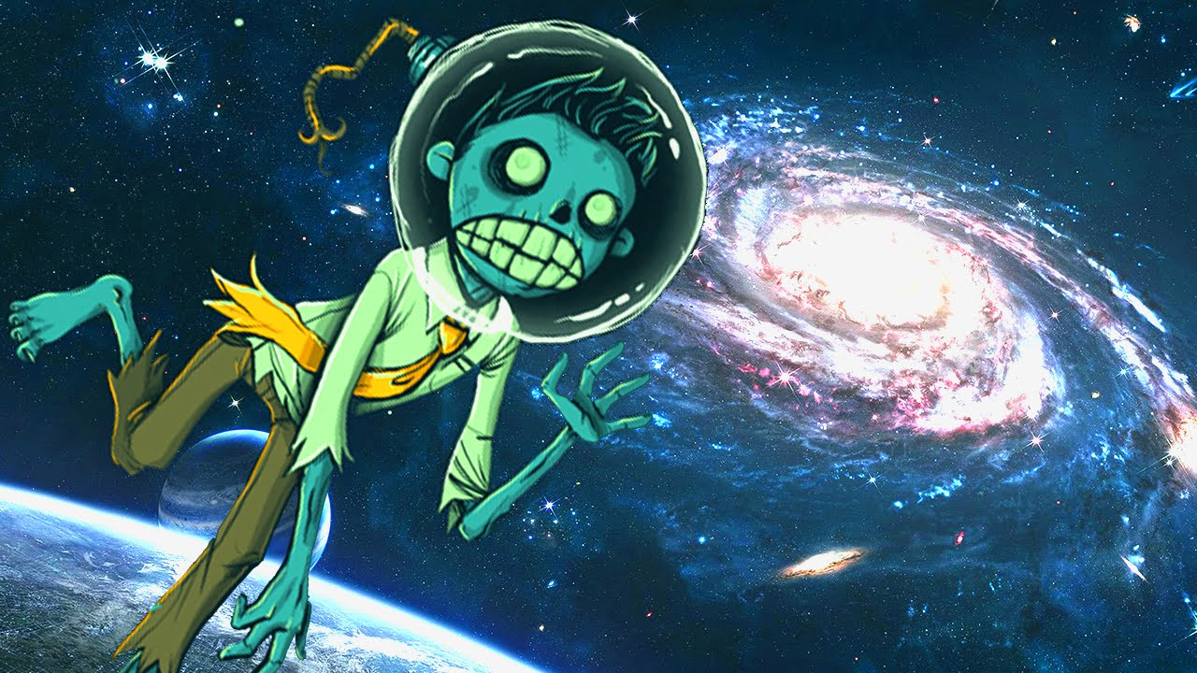
Should be able to push integers onto the stack

Slide 49
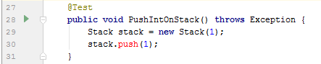
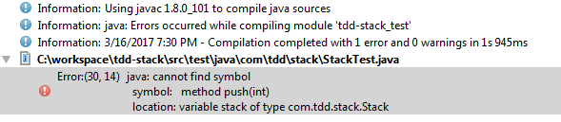

Slide 50
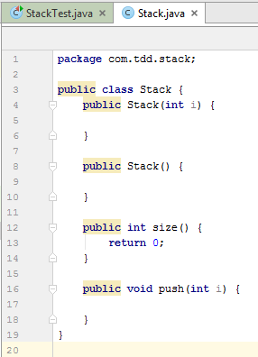
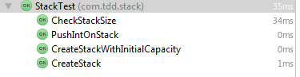

Slide 51
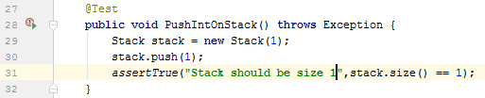
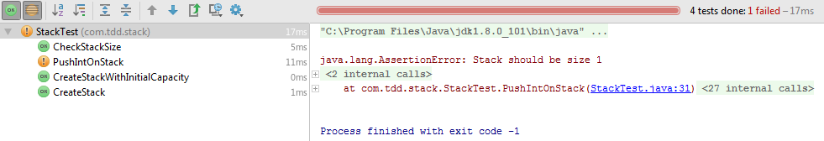

Slide 52
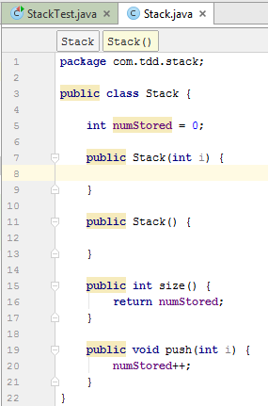
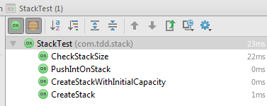

Slide 53
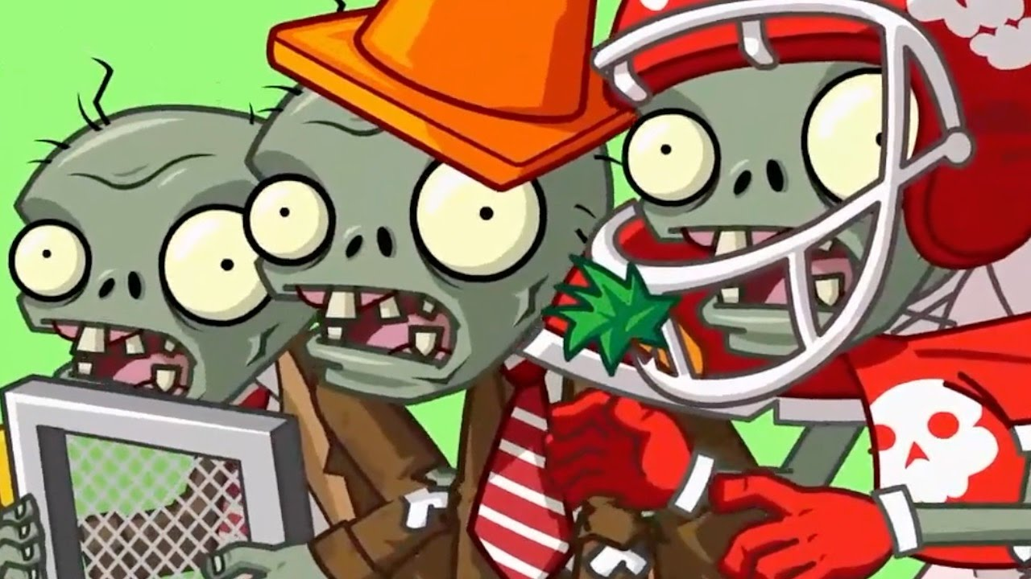
Should be able to pop integers off of the stack

Slide 54
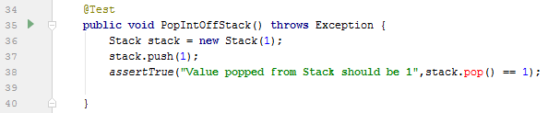
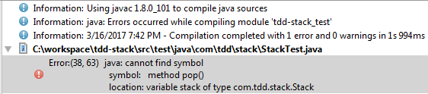

Slide 55
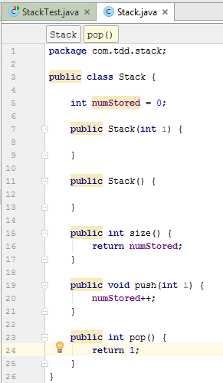
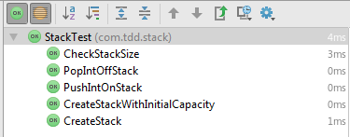

Slide 56
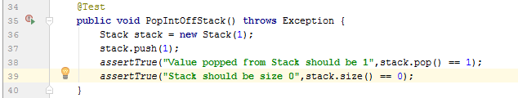
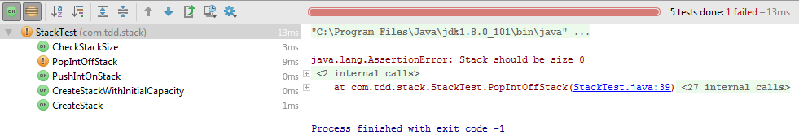

Slide 57
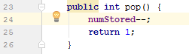
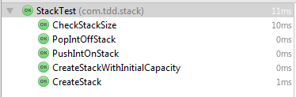

Slide 58
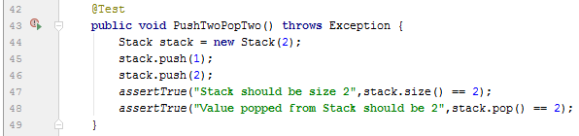
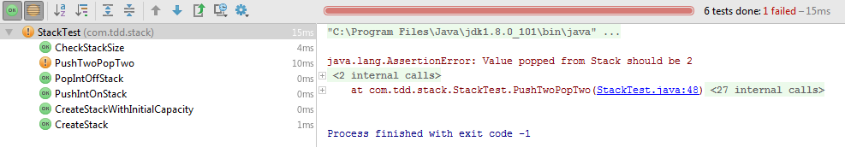

Slide 59
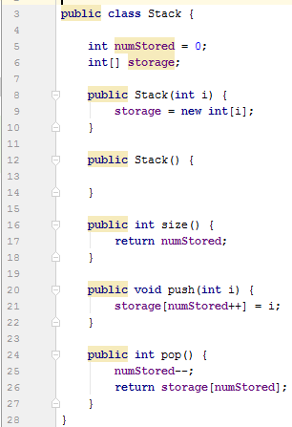
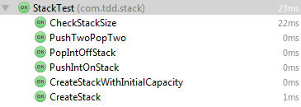

Slide 60
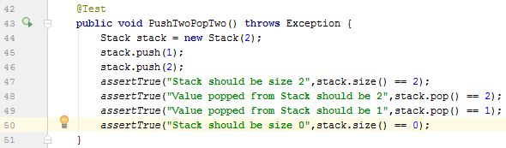
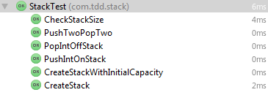

Slide 61
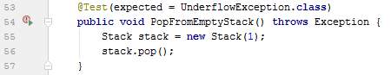
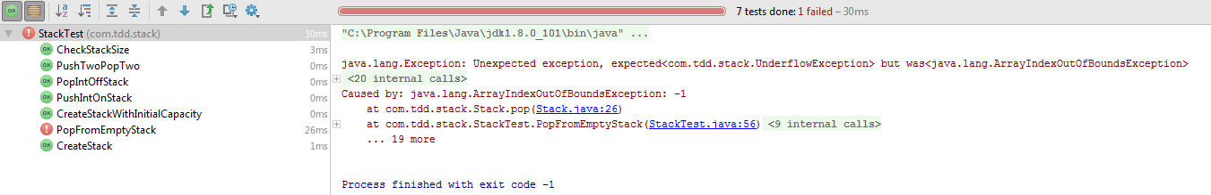

Slide 62
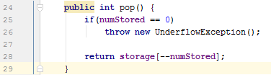
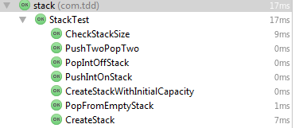

Slide 63
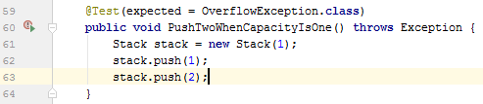
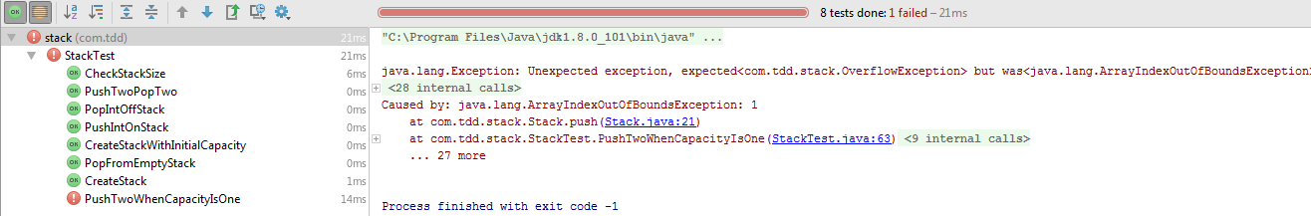

Slide 64
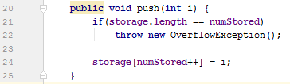
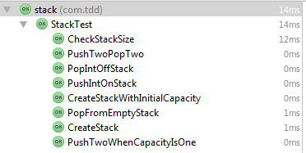

Slide 65

Should be able to peek at the integer on the stack without removing it

Slide 66
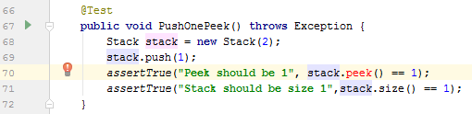
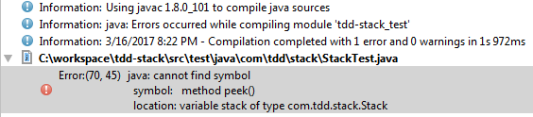

Slide 67



Slide 68



Slide 69



Slide 70



Slide 71



